Slide 1
Sci-fi Lab Blender Scene Viva Presentation
From Dimitrios Mantzidis
P2725916

Slide 2
Introduction
My project is a scene composed and rendered in Blender with all the texture made manually in Aseprite.
The theme of the scene is a Science Laboratory having an experiment escape containment and creating a mess.
The potential game for the project is a Wave Survival that you advance through the level by opening doors using currency earned through fighting.

Slide 3
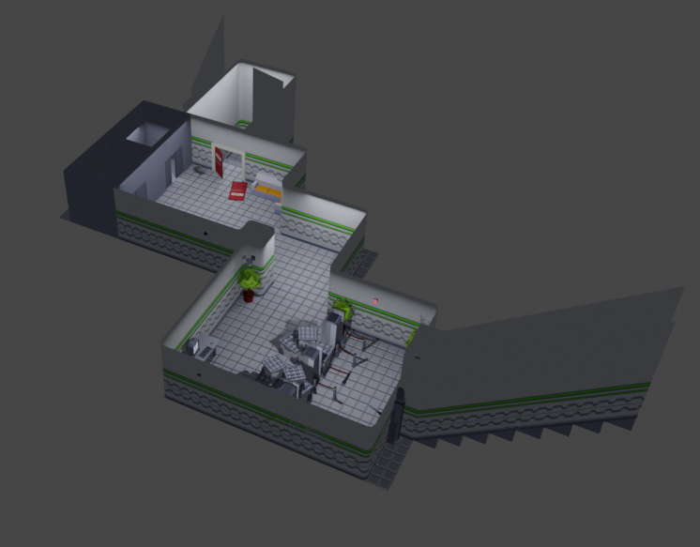
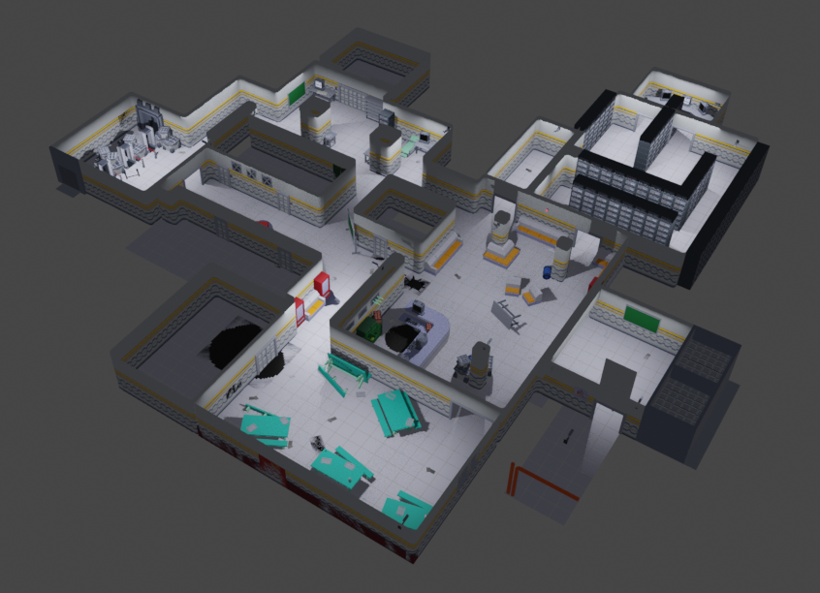
Overview
Top Floor
Bottom Floor
The scene is composed of 2 different Floors; the Top Floor and the Bottom Floor, both fully decorated to my fullest extend in the timeframe.

Slide 4
Aims and Goals
Create a fully decorated level with 3 floor, each increasing in difficulty as you descend.
Give life to the scene with various animated textures and particles
Manually make all the textures and their properties (Normals, Roughness ect.)
Showcase the story of what occurred on the level with just the level design

Slide 5



Development Process - Tools
For my project I used:
Blender to create all the models and build the scene
Aseprite to create all the textures for the models, including all the Normal, Roughness, Emissive and Height maps
ClipChamp to stitch together the renders and add effects for better viewing quality

Slide 6

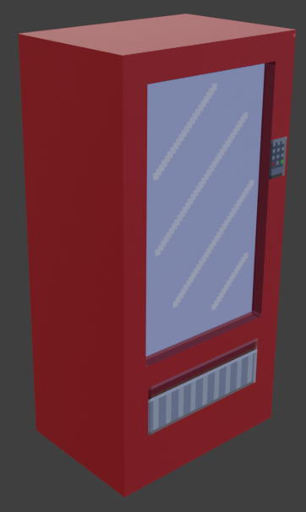
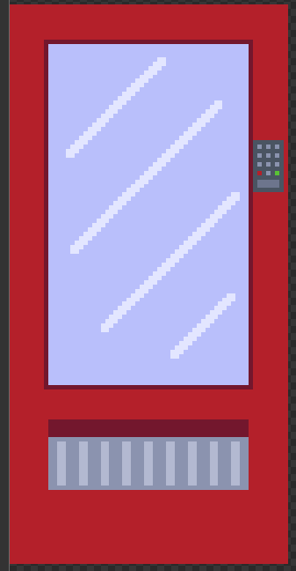
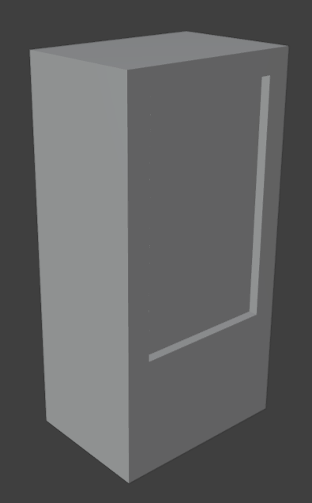
Development Process – Workflow Models
I only used primitive shapes with a few changed faces for all my objects to:
Reduce lag caused by many similar objects duplicated around the map
Make it easier to UV unwrap and add textures on the objects with minimal effort required.

Slide 7
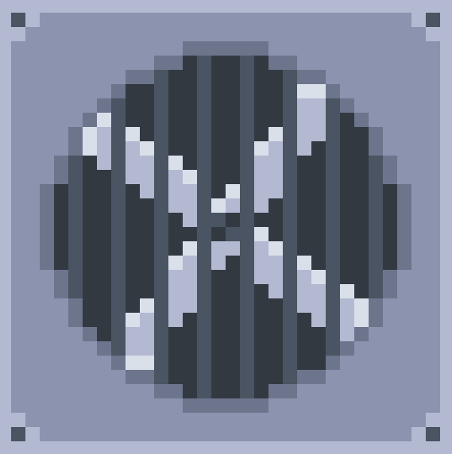

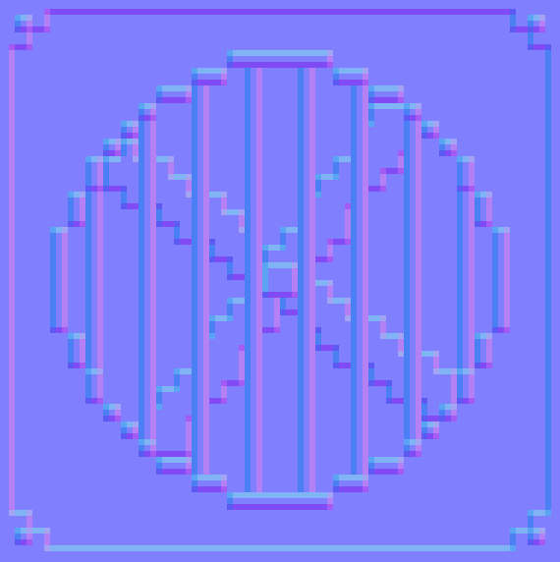

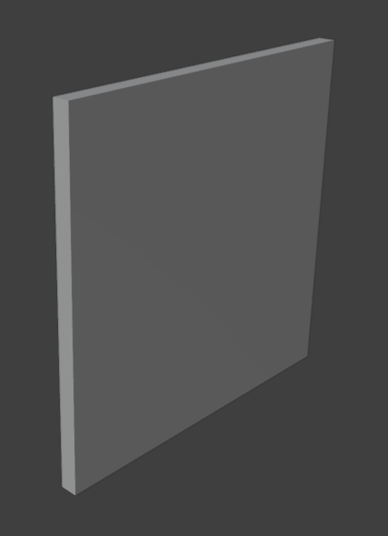
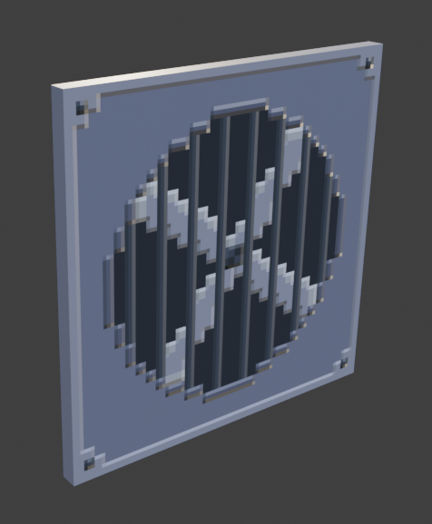
Development Process – Workflow Textures
For the textures I created separate layers for all the different textures required to make a flat face to look 3D.
Most of the textures come from 2 different texture files to minimize lag caused by multiple high-resolution textures.
Colour
Roughness
Normal
Height
Before
After

Slide 8
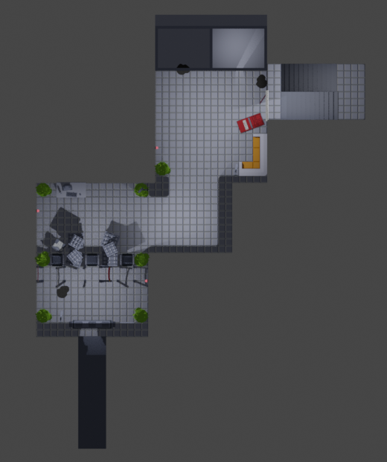
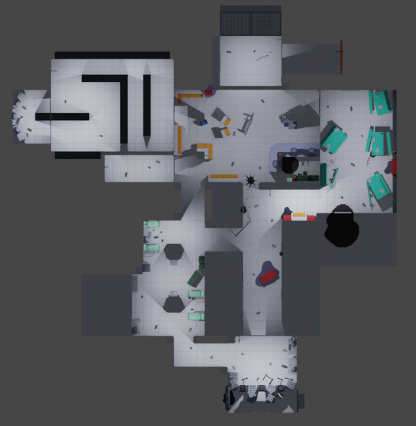
Development Process – Level Design
The top floor is the starter area for the player; it is a safe zone to help introduce the gameplay to the player.
The bottom floor is the actual level where the player can traverse the map, explore and fight. The floor is designed with multiple loops to prevent the player from being cornered.

Slide 9
Development Process - Milestones
Week 1 – Completed base Block-out for level
Week 2 – Began Block-out for models in the level
Week 3 – Began modelling finalised objects for the scene
Week 4 – Began creating textures for the models
Week 5 – Continued modelling and texture, and began Lighting
Week 6 – Polishing scene by adding various Decals and animated textures
Week 7 – Rendering scene and combining them in OBS

Slide 10
Development Process - Challenges
Completely finish all 3 floor, I was forced to not do the 3rd floor due to time constraints
Doing the Normal Maps for the textures took a long time and was difficult to get correct at the start
Restructure the layout of the level to fit the theme of a potential game

Slide 11
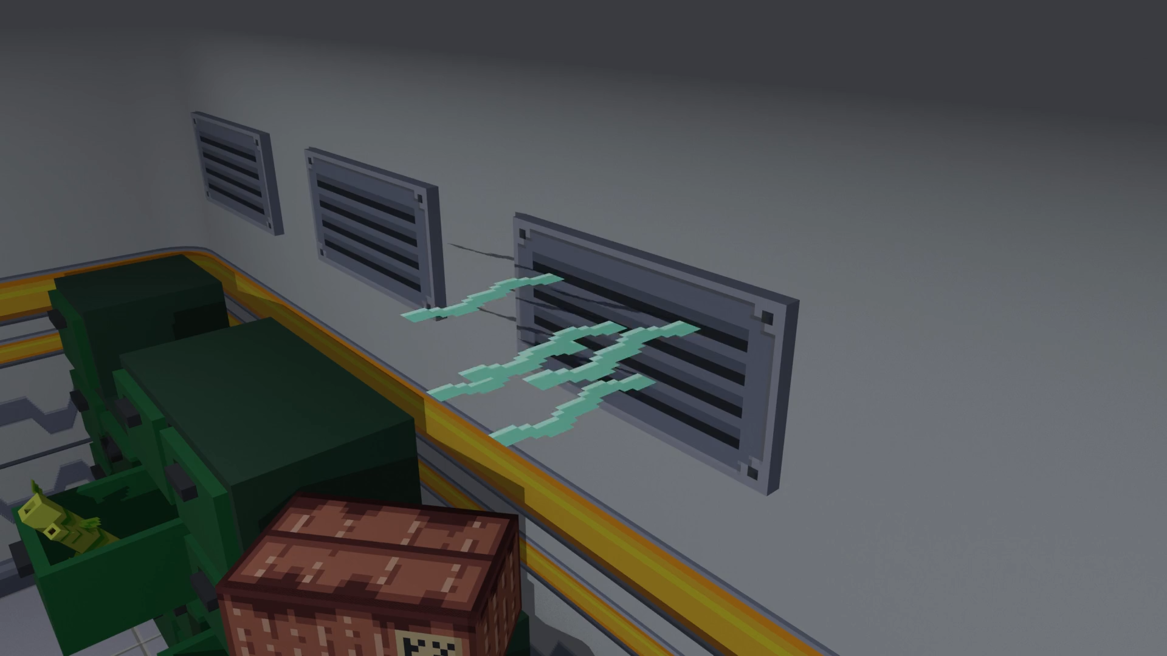
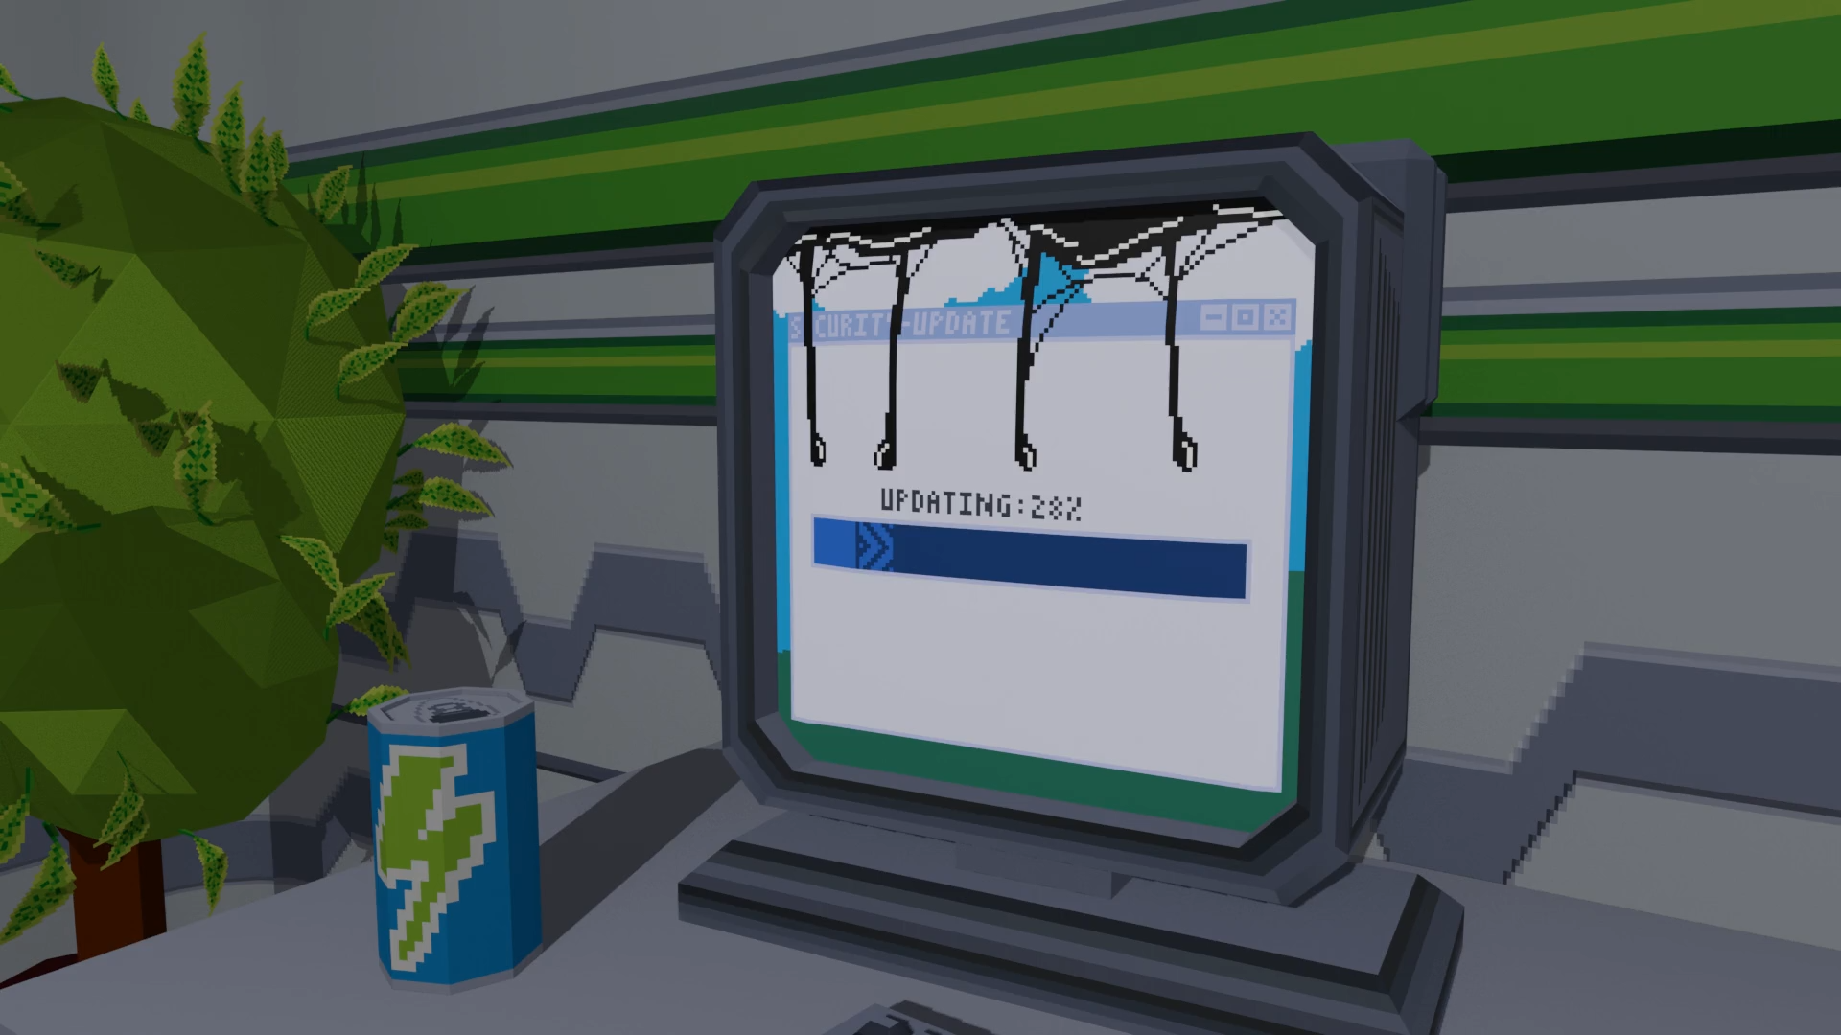
Demo – Animated Textures
These are the animated textures I had time to implement in the level.
I had made plans to create more but most of them resided on the 3rd floor of which I had not done.

Slide 12
Reflection - Shortened
While I believe I did a good job, I could have improved on:
Better time management to have completed the 3rd floor
Experiment with other texturing processes to have found a more efficient way to get the same or better results
Do more research at the start for a better grasp of the environment I was building

Slide 13
Testing
For testing, I mostly focused on 1 quality I wanted to perfect in the scene, which was performance.
To test to see if my scene has high performance on lower end computers I used:
A GPU limiter to force my laptop to run with less GPU to see how it would handle the project
Use the Library computers at university who are on the lower end of computers and achieve a stable 30 fps while in Cycles
I was successful at being able to run at 30 fps on both tests consistently

Slide 14
Next Step
If I were to continue this project, I would:
Complete the 3rd floor entirely
1
Create more variations of models and decals
2
Implement more animated textures and particles to the scene
3
Add sound effects or ambience sound
4

Slide 15
Questions
Any questions?

